Slide 1








With
Rick McGough
PART 6

Slide 2


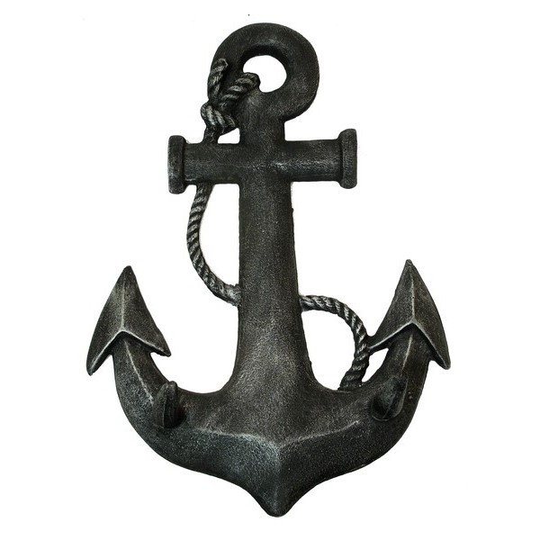
Faith & Reason
Made Simple
(Part 6)
The Anchor
of our Faith

Slide 3


1 – Internal Unity
2 – Bibliographical Evidence
3 – Archaeology & History
4 – Medical Facts
5 – Scientific Facts
6 – Fulfilled Prophecy
a – Ancient Cities b – World Empires
c – Messianic
d – Jews Return to Israel
e – End Times/Jerusalem
7 – Changed Lives
8 – Indestructibility & Distribution

Slide 4
(5) Scientific
Facts

Slide 5

The Bible – God’s Word!
The Earth is a Sphere (Isaiah 40:22)
Scientific Facts Found in the Ancient Scriptures

Slide 6
The Bible – God’s Word!
The Earth is a Sphere (Isaiah 40:22)
The Earth Hangs on Nothing (Job 26:7)
Scientific Facts Found in the Ancient Scriptures

Slide 7
The Bible – God’s Word!
The Earth is a Sphere (Isaiah 40:22)
The Earth Hangs on Nothing (Job 26:7)
The Heavens (Universe) are Being Stretched Out
(Job 9:8) (Psalm 104:2) (Isaiah 45:12) (7 Other Places)
Scientific Facts Found in the Ancient Scriptures

Slide 8
The Bible – God’s Word!
The Earth is a Sphere (Isaiah 40:22)
The Earth Hangs on Nothing (Job 26:7)
The Heavens (Universe) are Being Stretched Out
(Job 9:8) (Psalm 104:2) (Isaiah 45:12) (7 Other Places)
Springs Within the Seas & Oceans (Job 38:16)
Scientific Facts Found in the Ancient Scriptures

Slide 9

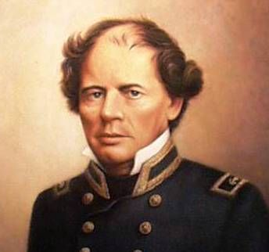
Psalms 8:8 NASB The birds of the heavens and the fish of the sea, Whatever passes through the paths of the seas.

Slide 10
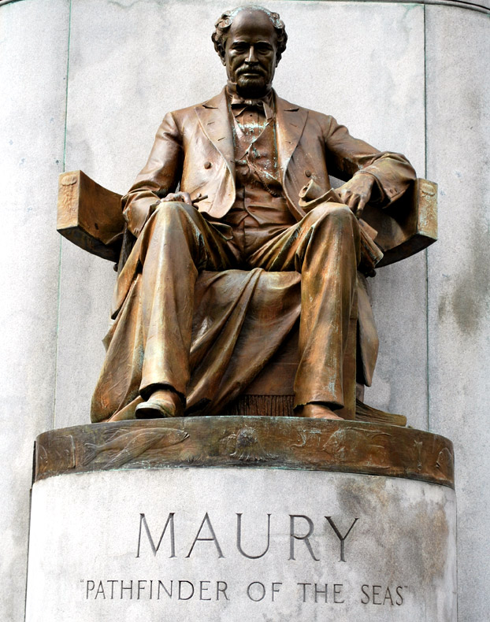
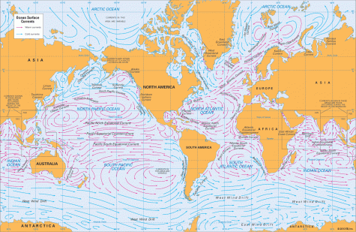

The oceanography pioneer Matthew Maury (1806–1873) was led by Psalm 8:8 to chart water currents. As Maury pointed out, ‘The Bible is [the] authority for everything it touches’—not just doctrine, but science and history as well. His work revolutionized shipping by drastically cutting travel times.

Slide 11
(6) Fulfilled
Prophecy

Slide 12
(6) Fulfilled
Prophecy - A
Destruction of Ancient Cities

Slide 13
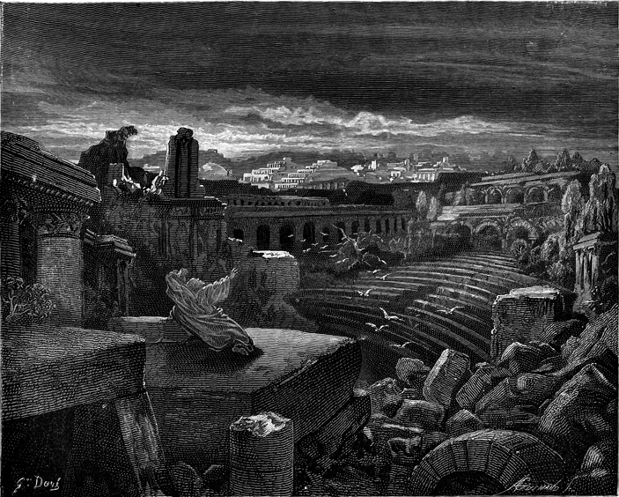
The Bible – God’s Word
Fulfilled Prophecy –
Destruction of Ancient Cities
(Babylon, Petra, Tyre, Etc.)

Slide 14
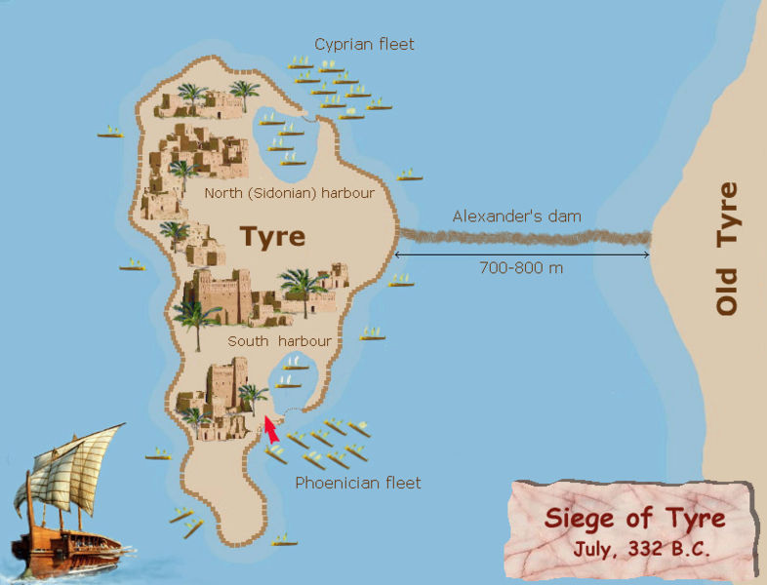
Ezekiel 26:4 NASB 'They will destroy the walls of Tyre and break down her towers; and I will scrape her debris from her & make her a bare rock.

Slide 15
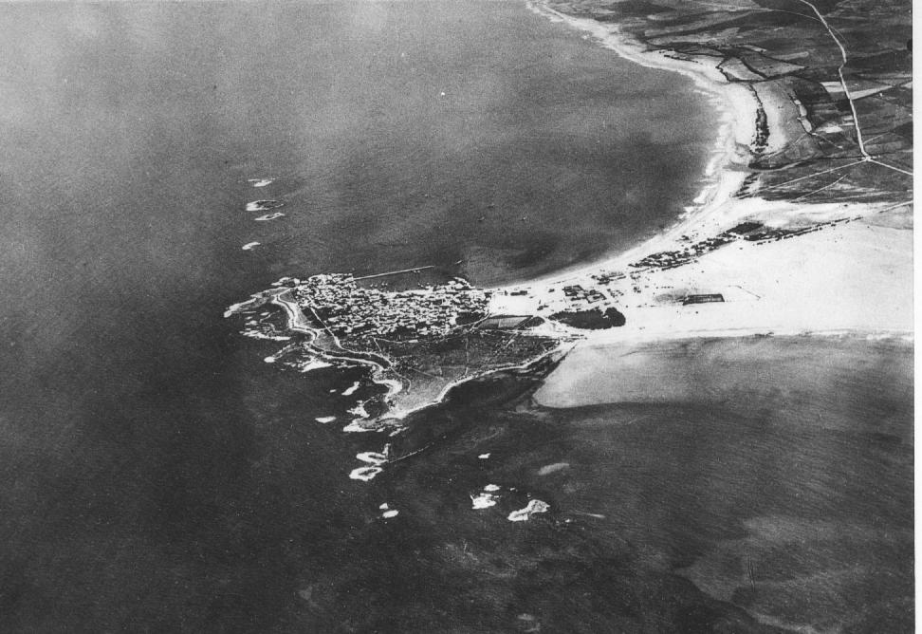
Arial View of Tyre
from 1934

Slide 16
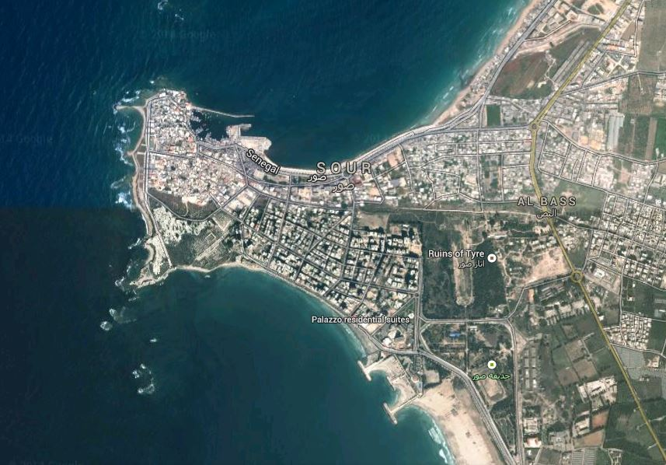

Slide 17
(6) Fulfilled
Prophecy - B
World Empires

Slide 18

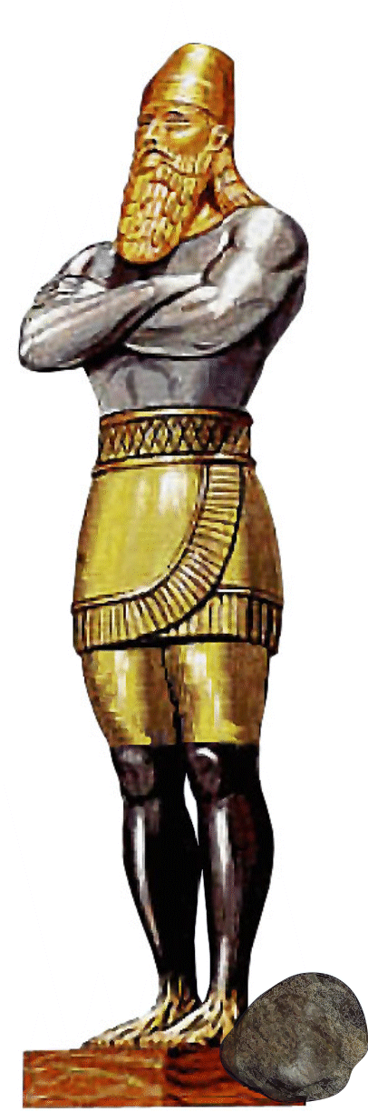
The Bible – God’s Word
Fulfilled Prophecy –
World Empires
(Babylonian, Medo-Persian,
Greek, Roman)
Daniel 2, 7 & 8

Slide 19
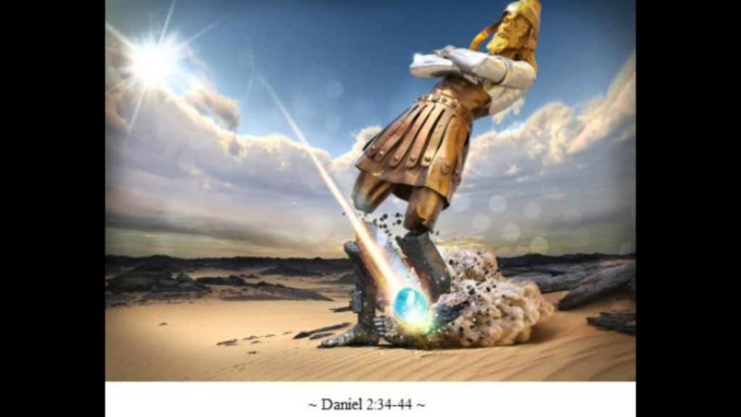
Head of Gold
Babylonian
(B.C. 603 – 539)
Breast of Silver
Medo-Persia
(B.C. 539 - 331)
Loins of Brass
Greek
(B.C. 331 - 168)
Legs of Iron
Roman
(B.C. 168 – A.D. 476)
Destroying Rock
Kingdom of Christ
Feet of Iron & Clay
Divided Nations
(A.D. 476 - Present)

Slide 20
(6) Fulfilled
Prophecy - C
Messianic Prophecies

Slide 21
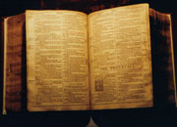
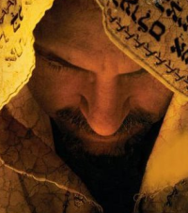
The Bible – God’s Word
Over 300 O.T. Prophecies Fulfilled by Jesus Christ
* More Details will be
covered in the following
session dealing with
Jesus as the Messiah

Slide 22
(6) Fulfilled
Prophecy - D
Regathering of the Jews

Slide 23

The Bible – God’s Word
Prophecy Fulfilled
Scattering & Regathering
of the Jewish People
(The Land of Israel)

Slide 24
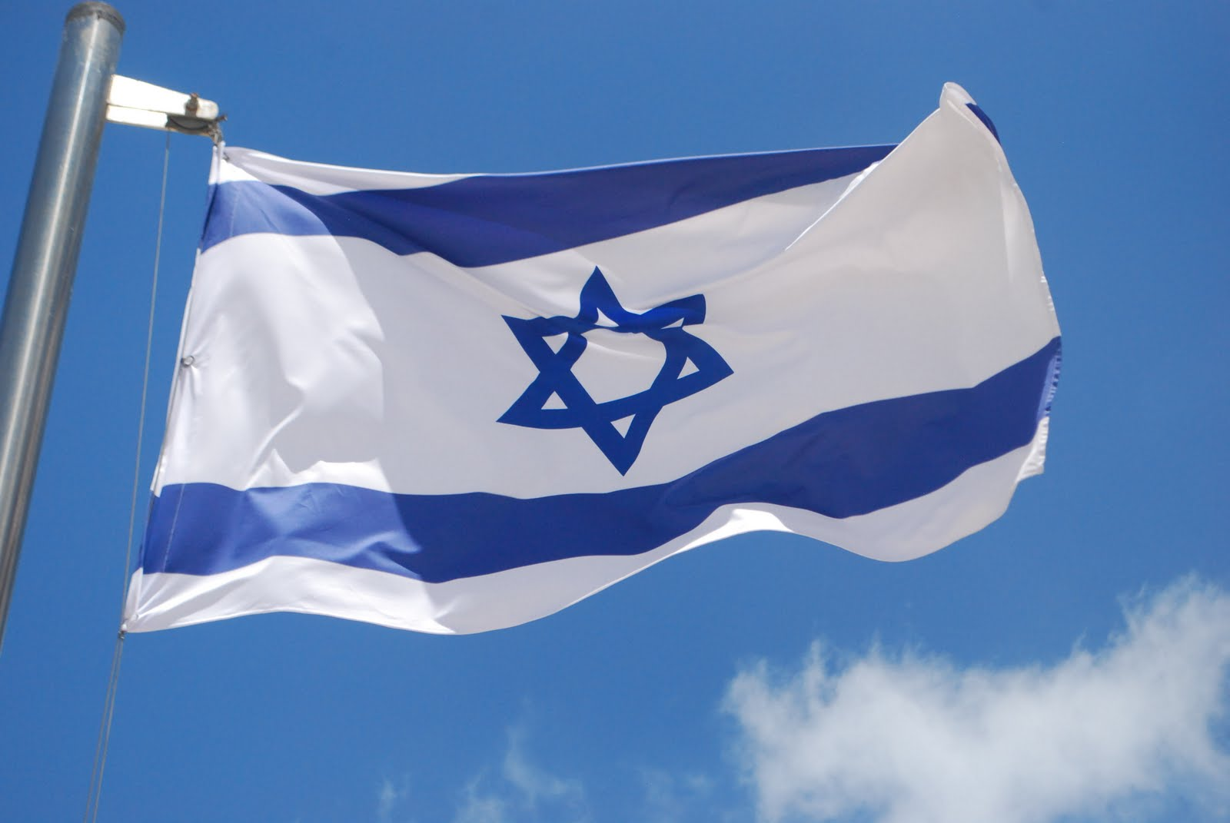
Scattering & Regathering of the Jewish People
Ezekiel 36:24 NASB "For I will take you from the nations, gather you from all the lands and bring you into your own land.

Slide 25
Scattering & Regathering of the Jewish People
Isaiah 11:11-12 NASB Then it will happen on that day that the Lord will again recover the second time with His hand The remnant of His people, who will remain, From Assyria, Egypt, Pathros, Cush, Elam, Shinar, Hamath, And from the islands of the sea. (12) And He will lift up a standard for the nations And assemble the banished ones of Israel, And will gather the dispersed of Judah from the four corners of the earth.

Slide 26
Scattering & Regathering of the Jewish People
Ezekiel 38:8 NASB "After many days you will be summoned; in the latter years you will come into the land that is restored from the sword, whose inhabitants have been gathered from many nations to the mountains of Israel which had been a continual waste; but its people were brought out from the nations, and they are living securely, all of them.

Slide 27
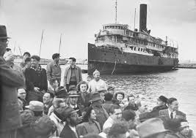

Slide 28
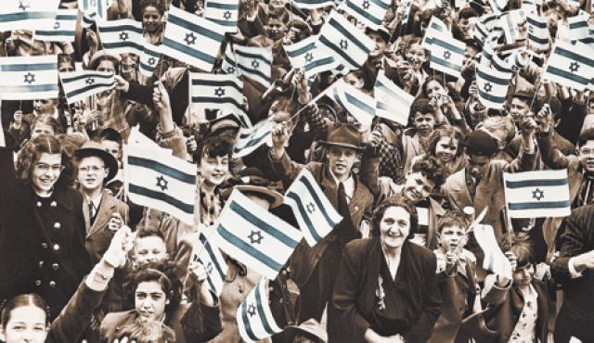

Slide 29
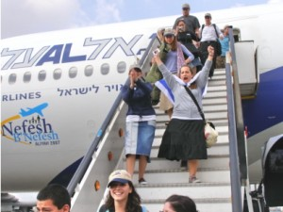
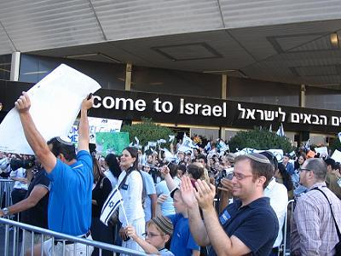


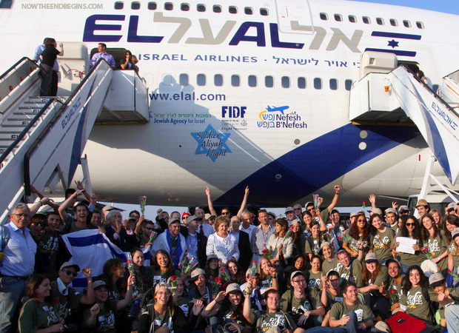
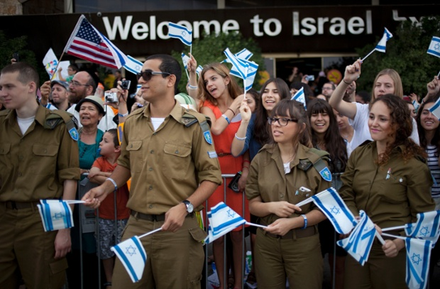
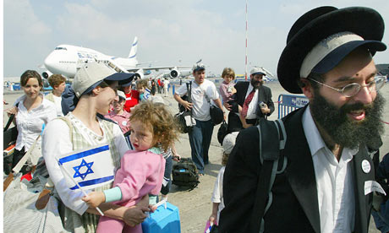

Slide 30
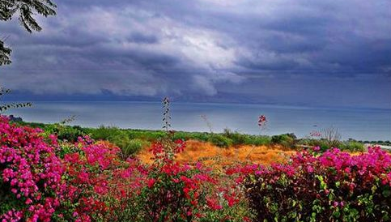
Scattering & Regathering of the Jewish People
Ezekiel 36:30-35 NASB "I will multiply the fruit of the tree and the produce of the field, so that you will not receive again the disgrace of famine among the nations. … (34) "The desolate land will be cultivated instead of being a desolation in the sight of everyone who passes by. (35) "They will say, 'This desolate land has become like the garden of Eden; and the waste, desolate and ruined cities are fortified and inhabited.'

Slide 31
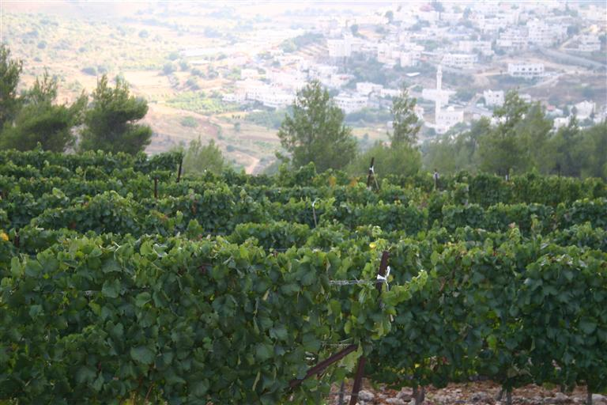
The Land will Blossom & Become Fruitful
Ezekiel 36:8-11 NASB 'But you, O mountains of Israel, you will put forth your branches and bear your fruit for My people Israel; for they will soon come. (9) 'For, behold, I am for you, and I will turn to you, and you will be cultivated and sown. (10) 'I will multiply men on you, all the house of Israel, all of it; and the cities will be inhabited and the waste places will be rebuilt. (11) 'I will multiply on you man and beast; and they will increase and be fruitful; and I will cause you to be inhabited as you were formerly and will treat you better than at the first. Thus you will know that I am the LORD.

Slide 32
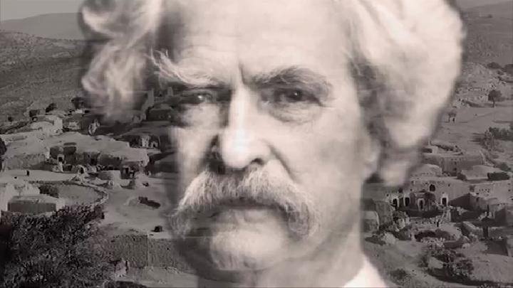
Mark Twain
(1867)
“It is a hopeless, dreary, heart-broken land. “
“… a silent, mournful expanse “

Slide 33

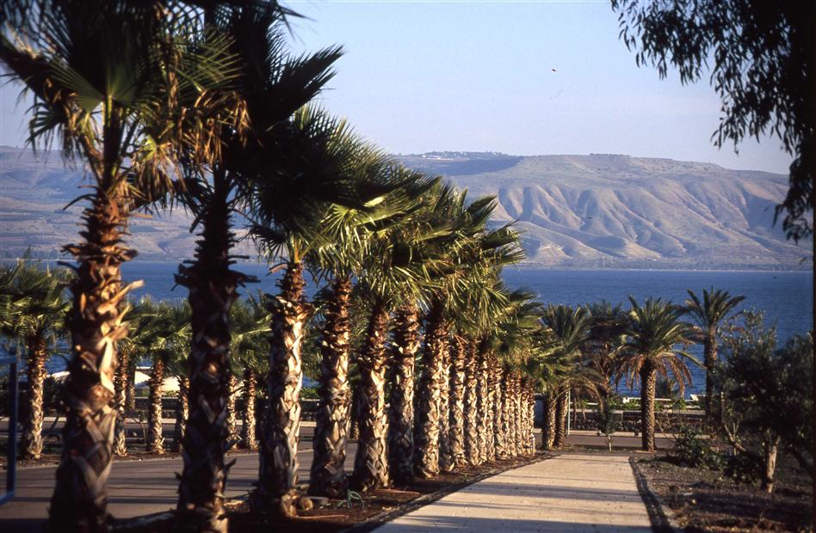
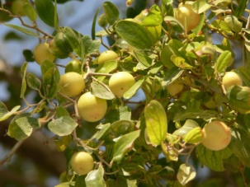

More than 400 Million Trees Planted

Slide 34
More than 400 Million Trees Planted
Rains Have Returned

Slide 35
More than 400 Million Trees Planted
Rains Have Returned
World Class Irrigation Systems

Slide 36
More than 400 Million Trees Planted
Rains Have Returned
World Class Irrigation Systems
Fruit Exporting Nation

Slide 37
More than 400 Million Trees Planted
Rains Have Returned
World Class Irrigation Systems
Fruit Exporting Nation
Leader in Technology

Slide 38
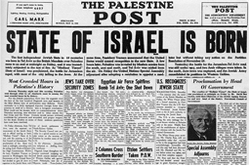

Isaiah 66:8 NASB … “Can a land be born in one day? Can a nation be brought forth all at once? As soon as Zion travailed, she also brought forth her sons.”

Slide 39
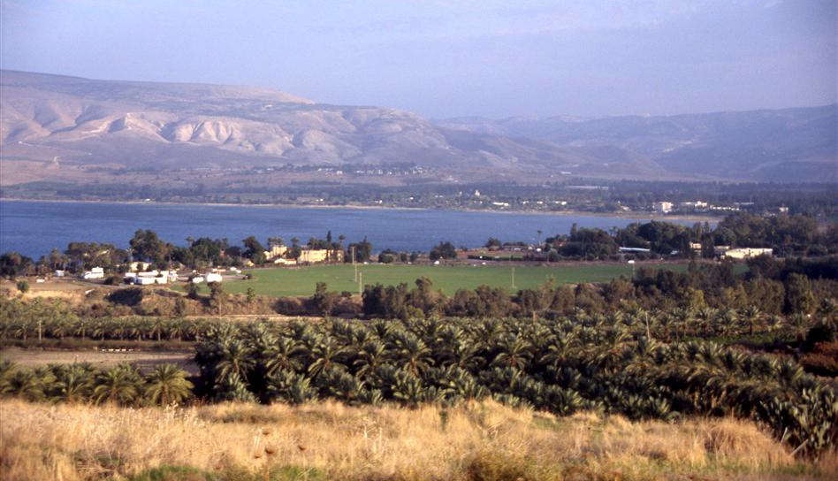
Ezekiel 28:26 KJV And they shall dwell safely therein, and shall build houses, and plant vineyards; yea, they shall dwell with confidence, when I have executed judgments upon all those that despise them round about them; and they shall know that I am the LORD their God.

Slide 40
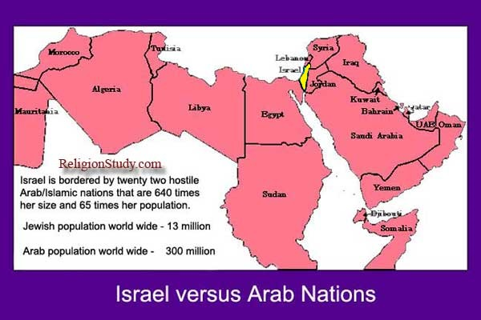
Survived 8
Defensive
Wars
Since 1947
+
2 Palestinian
Intifadas
+
A Series of
Armed
Conflicts
Israel

Slide 41

Israel
Modern Wars
& Miracles
When Israel declared its independence in May 1948, the army did not have a single cannon or tank. Its air force consisted of nine obsolete planes. (60,000 trained soldiers but only 18,900 mobilized, armed & prepared for war)

Slide 42
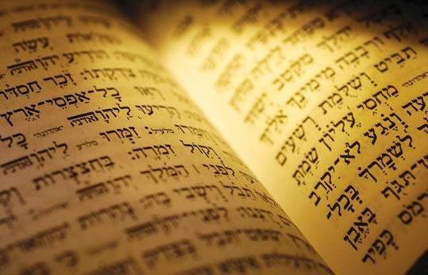
Hebrew Language Restored
Zephaniah 3:9 JUB For then I will restore to the peoples the pure language that they may all call upon the name of the LORD to serve him with one consent.

Slide 43
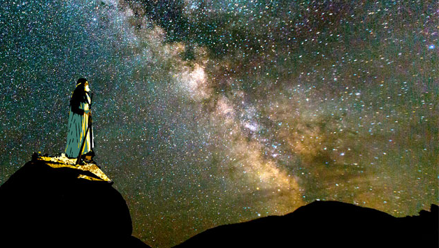
Genesis 12:2-3 NIV "I will make you into a great nation, … and all peoples on earth will be blessed through you."

Slide 44
Genesis 22:18 NIV “and through your offspring all nations on earth will be blessed,”

Slide 45
Genesis 26:4 NIV … “and through your offspring all nations on earth will be blessed,”

Slide 46
Genesis 28:14 NIV … “All peoples on earth will be blessed through you and your offspring.”

Slide 47

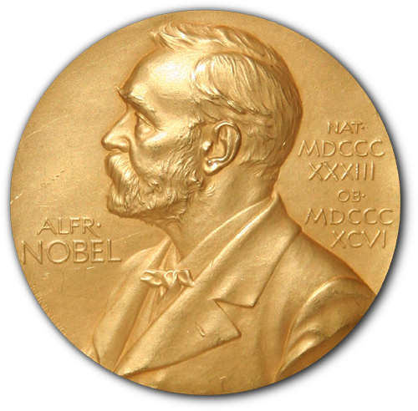
As of 2017, Nobel Prizes have been awarded to 892 individuals, of whom 201 or 22.5% were Jews, although the total Jewish population comprises less than 0.2% of the world's population. This means the percentage of Jewish Nobel laureates is at least 112.5 times or 11,250% above average. (1901-2017) (Wikipedia)

Slide 48
(6) Fulfilled
Prophecy - E
End Times &
The City of Jerusalem

Slide 49
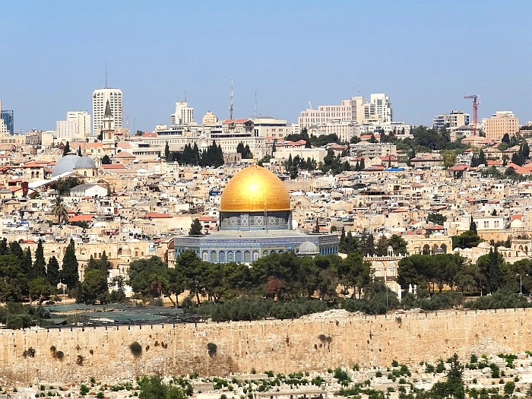
The Bible – God’s Word
Prophecy Fulfilled – End Times
City of Jerusalem
(Zechariah 12 & 14 )
(The Nations will Surround)

Slide 50
City of Jerusalem
Zechariah 12:2-3 NASB "Behold, I am going to make Jerusalem a cup that causes reeling to all the peoples around; and when the siege is against Jerusalem, it will also be against Judah. (3) "It will come about in that day that I will make Jerusalem a heavy stone for all the peoples; all who lift it will be severely injured. And all the nations of the earth will be gathered against it.

Slide 51
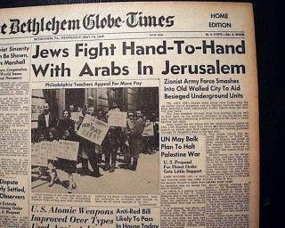
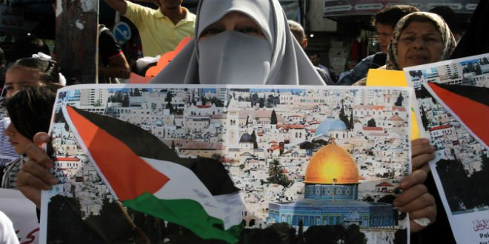
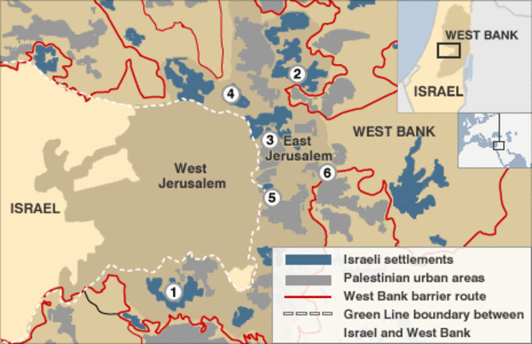
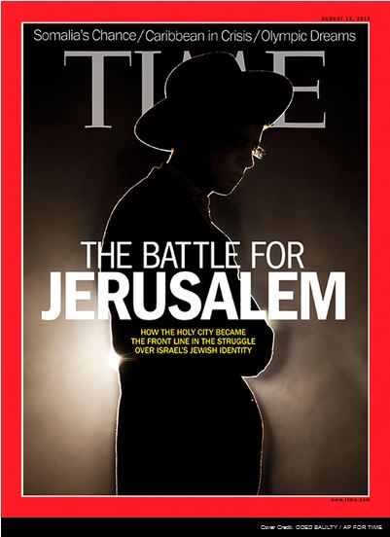
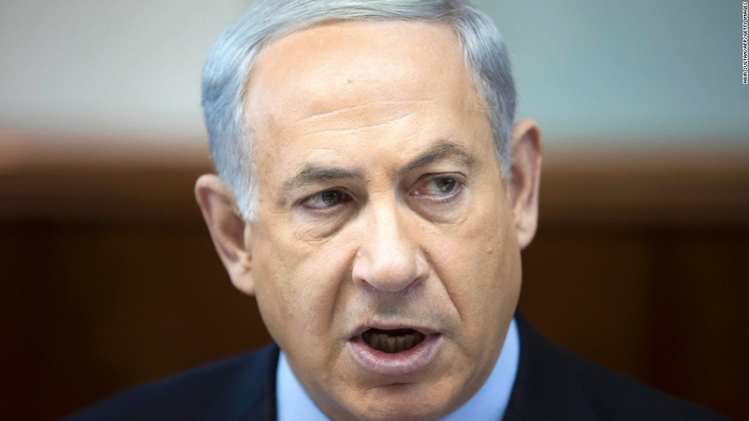
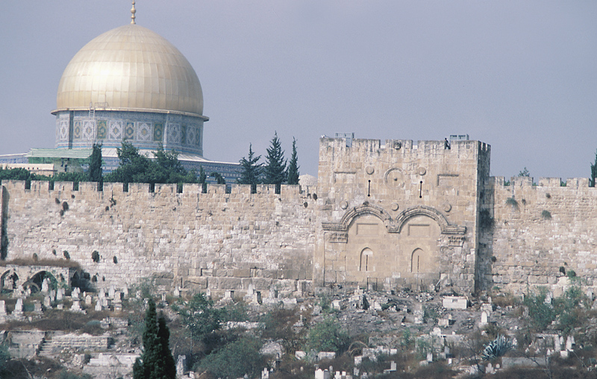


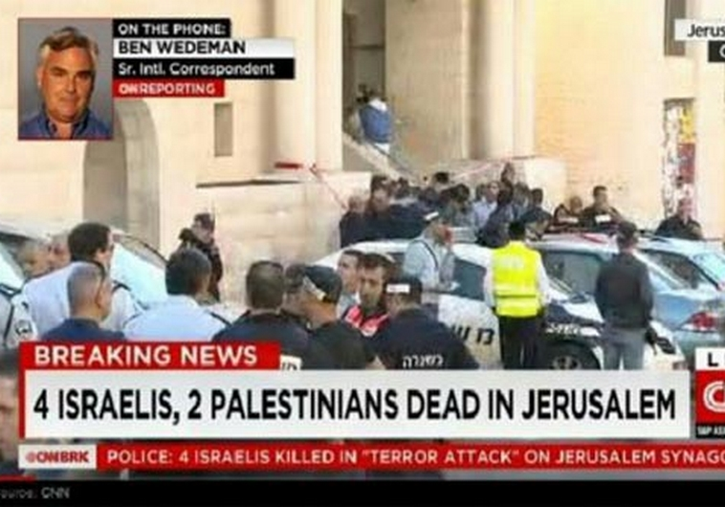

Slide 52
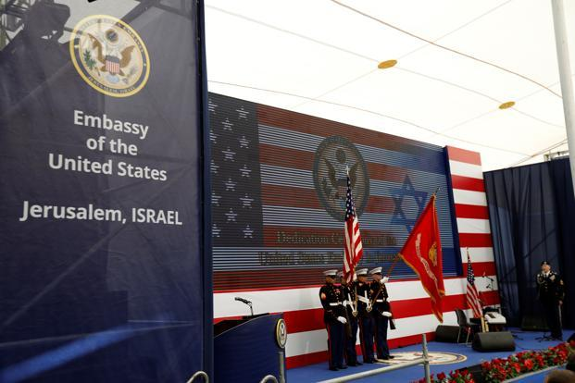
U.S. Opens Embassy in Jerusalem
(May 14, 2018)
*Acknowledging Jerusalem
as the Capital of Israel

Slide 53
U.S. Opens Embassy in Jerusalem
(May 14, 2018)
* Exactly 70 Years From The Birth
of the Modern State of Israel

Slide 54
U.S. Opens Embassy in Jerusalem
(May 14, 2018)
* Numerous Other Nations Have
Since Followed the U.S.’s Lead

Slide 55
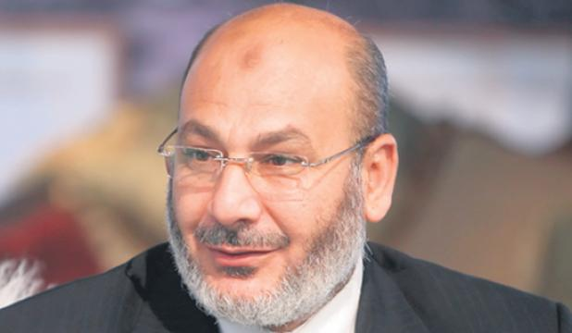
Islamic Cleric – Safwat Higazi
May 1, 2012 – Cairo, Egypt

Slide 56
“We can see how the dream of the Islamic
Caliphate is being realized …”
Islamic Cleric – Safwat Higazi
May 1, 2012 – Cairo, Egypt

Slide 57
“Our capital shall not be Cairo, Mecca, or
Medina. It shall be Jerusalem”
Islamic Cleric – Safwat Higazi
May 1, 2012 – Cairo, Egypt

Slide 58
“Yes, Jerusalem is our goal. We shall pray in
Jerusalem, or else we shall die as martyrs
on its threshold”
Islamic Cleric – Safwat Higazi
May 1, 2012 – Cairo, Egypt

Slide 59
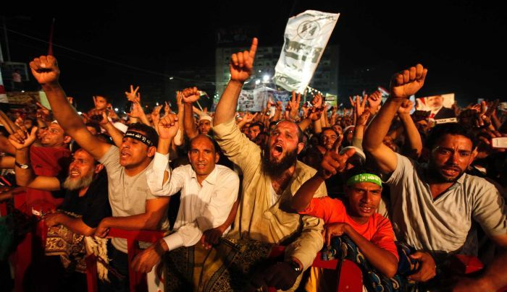
“Millions of martyrs march toward Jerusalem!”
(Chant)

Slide 60


The Bible – God’s Word
Prophecy Fulfilled – End Times
End Time
Prophecies
Immorality,
Turmoil in Nations,
New World Order,
666, Etc.)

Slide 61
The Bible – God’s Word
Prophecy Fulfilled – End Times
Revelation 13:16-18 NASB (16) And he causes all, the small and the great, and the rich and the poor, and the free men and the slaves, to be given a mark on their right hand or on their forehead, (17) and he provides that no one will be able to buy or to sell, except the one who has
End Time
Prophecies
Immorality,
Turmoil in Nations,
New World Order,
666, Etc.)
the mark, either the name of the beast or the number of his name. (18) Here is wisdom. Let him who has understanding calculate the number of the beast, for the number is that of a man; and his number is six hundred and sixty-six.

Slide 62
The Bible – God’s Word
Prophecy Fulfilled – End Times
End Time
Prophecies
Immorality,
Turmoil in Nations,
New World Order,
666, Etc.)

Slide 63

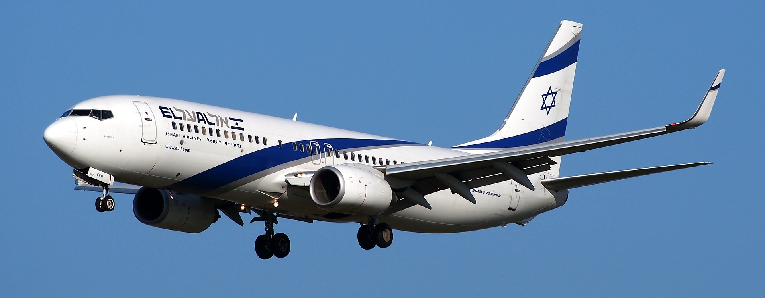

Daniel 12:4 (NASB) “But as for you, Daniel, conceal these words and seal up the book until the end of time; many will go back and forth, and knowledge will increase.”"
“

Slide 64
(7) Changed
Lives

Slide 65
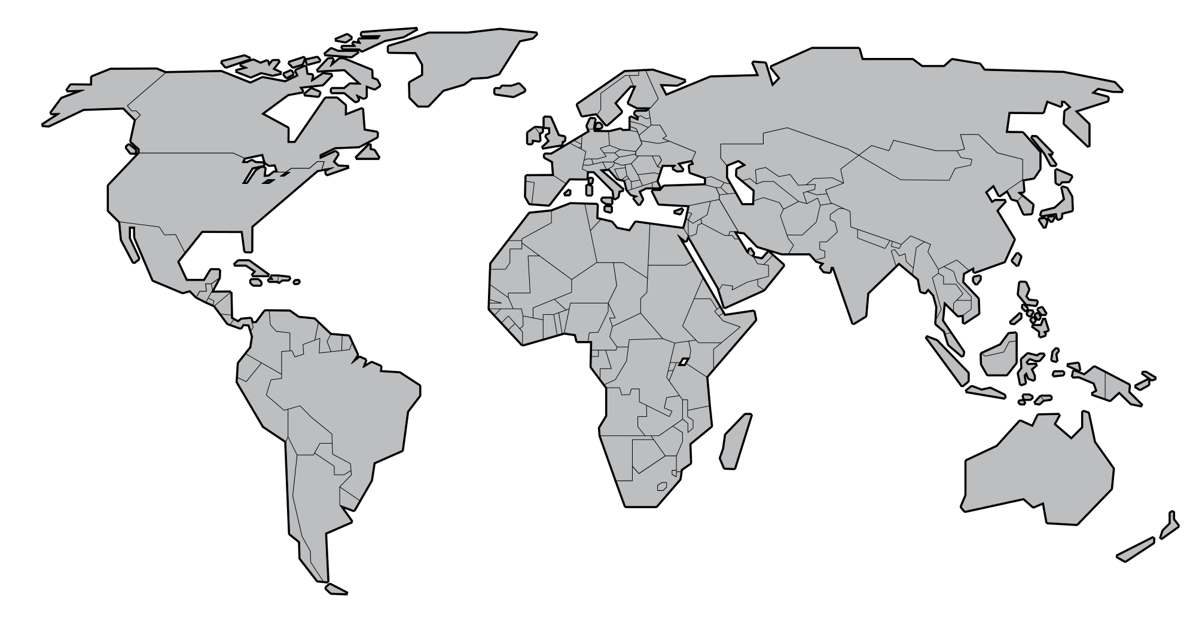
China
4 Million in 1949
160+ Million Now
Over 250 Million by 2030
Africa
9 Million Christians in 1900
380 Million by 2000
Over 600 Million by 2025
Latin America
90 % Christian
(Movement of Catholics
To Evangelical Christianity)

Slide 66

Muslims Coming to Know Christ
“In the last days,” says God, “I will pour out my Spirit on all people; your sons and your daughters shall prophesy, your old men shall dream dreams, and your young men shall see visions.” (Acts 2:17)

Slide 67
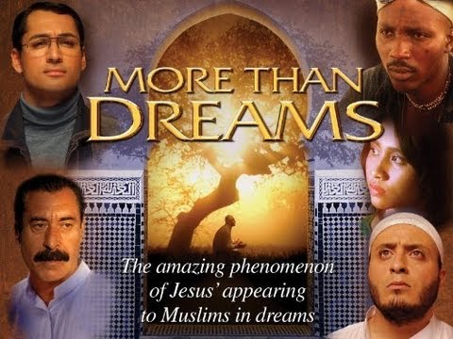

Slide 68


Slide 69
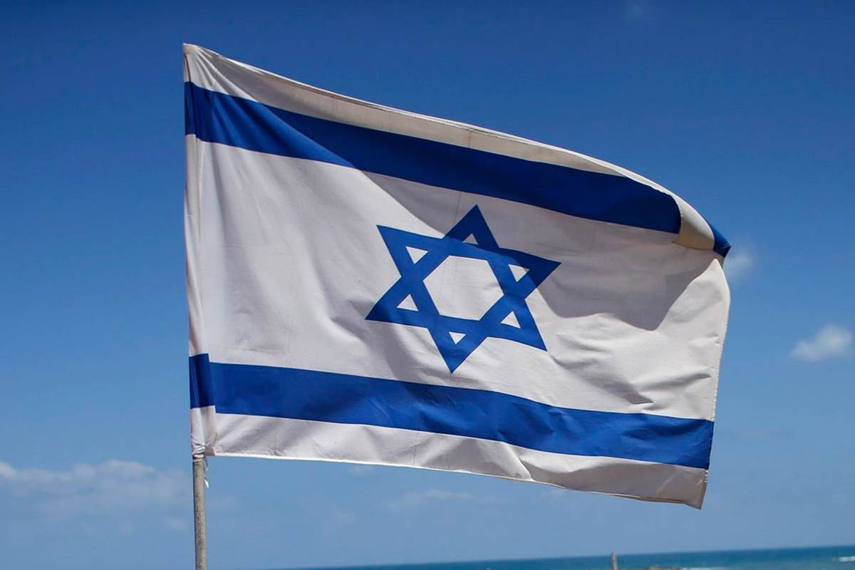

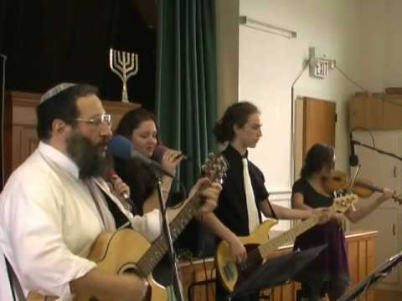
In 1973 there were an estimated
2,000 Messianic Jews
Today there are an estimated
300,000 Messianic Jews

Slide 70

Joel Rosenberg Blog
(Sept. 2015)
“Since Yom Kippur of 2014
Millions of Jews have
begun searching for the
Messiah and for atonement
for their sins.”

Slide 71
(8)
Indestructibility
& Distribution

Slide 72
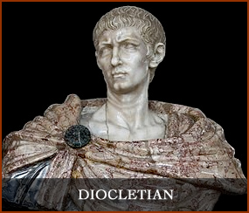
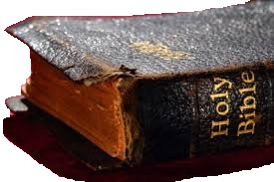
Diocletian (284-316) His royal edicts were published everywhere, commanding that the churches be leveled to the ground and the Scriptures destroyed by fire" After two years, Diocletian boasted, "I have completely exterminated the Christian writings from the face of the earth!"
History tells us that the next ruler, Constantine, became a Christian. He requested that copies of the Scriptures be made for all the churches.

Slide 73
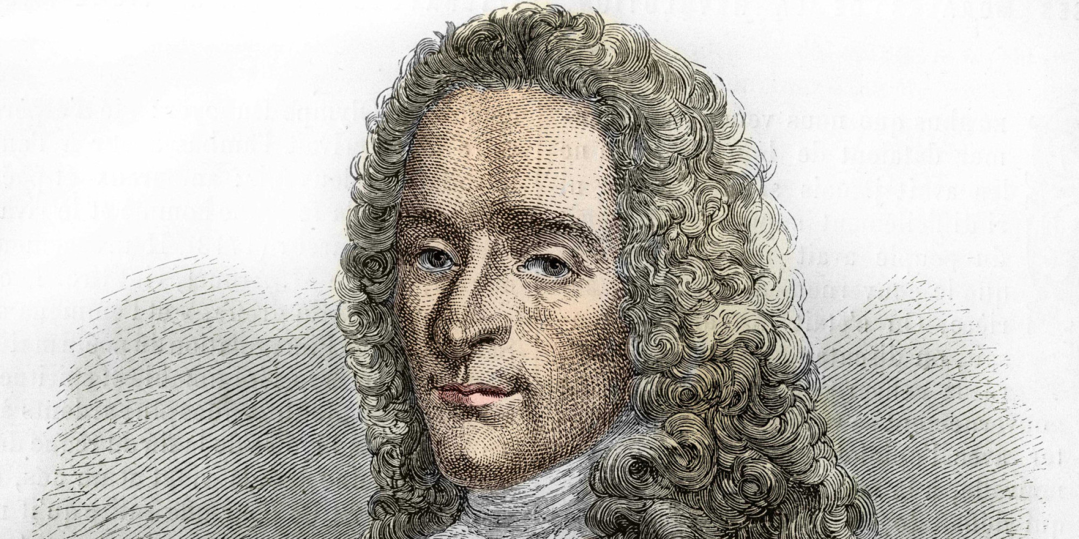
Voltaire (1694-1778) - He tried to destroy the Bible. He boldly made the prediction that within one hundred years the Bible and Christianity would have been swept from existence into oblivion.
Within 100 years, the very printing press upon which Voltaire had printed his infidel literature, was being used to print copies of the Bible. And afterward, the very house in which the boasting Voltaire had lived, was literally stacked with Bibles prepared by the Geneva Bible Society.

Slide 74


As of 2014 the Bible
was banned in
52 Countries
https://christiansareus.com/2014/01/07/the-bible-outlawed-in-52-countries/

Slide 75

Bible Distribution
* United States Bible Societies
(Over 400 Million Bible Portions Distributed Each Year)

Slide 76
Bible Distribution
* United States Bible Societies
(Over 400 Million Bible Portions Distributed Each Year)
* Gideons
Distributed 1 Billion Bibles & N.T. – (1908 - 2001)
Distributed a 2nd Billion – (2002 – 2015)
Averaging over 1 Million Every 4 Days
* Many Other Organizations Involved

Slide 77

Bible Translations
The Bible (or portions of the Bible) is
now translated into over 2,200 Languages
Wycliffe Bible Translators – “Vision 2025”

Slide 78
1 – Internal Unity
2 – Bibliographical Evidence
3 – Archaeology & History
4 – Medical Facts
5 – Scientific Facts
6 – Fulfilled Prophecy
a – Ancient Cities b – World Empires
c – Messianic
d – Jews Return to Israel
e – End Times/Jerusalem
7 – Changed Lives
8 – Indestructibility & Distribution

Slide 79
With
Rick McGough
PART 6

Slide 80

For More Information
Or to Schedule a
Speaking Engagement
Contact Rick at
pastorrick@newlifeqca.com
or at 309-738-4863

